Slide 1

Bank Customer Churn Analysis
Using Excel and SQL to identify at-risk customers and reduce churn
DIVYA MISHRA
SKILLUP ONLINE

Slide 2

Why Customer Churn Matters
The Challenge
Customer churn is a major challenge for banks. When customers close accounts or stop using services, it impacts revenue and growth.
Retaining existing customers is more cost-effective than acquiring new ones, making churn analysis critical for business success.

Slide 3
Project Objectives
Calculate Churn Rate
Demographic Analysis
Financial Indicators
Risk Profiles
Identify high-risk customer segments
Determine overall customer churn percentage
Analyze churn by age, gender, and geography
Study relationships between churn, balance, and credit scores
Recommendations
Provide data-driven strategies to reduce churn

Slide 4
Dataset Overview
10K
13
Total Customers
Data Fields
Comprehensive dataset with unique customer IDs
Demographics, financials, and behavior metrics
Key Variables
Customer demographics: Age, gender, geography
Financial data: Credit score, balance, salary
Banking behavior: Products, tenure, activity status
Target variable: Exited (churned or active)

Slide 5
Data Preparation Process
01
02
03
Remove Duplicates
Handle Missing Values
Standardize Formats
Eliminated duplicate customer records for accuracy
Checked and addressed any gaps in the data
Converted categorical variables to consistent formats
04
05
Verify Labels
Treat Outliers
Confirmed churn status accuracy (1=Churned, 0=Active)
Addressed extreme values in balance and salary data

Slide 6
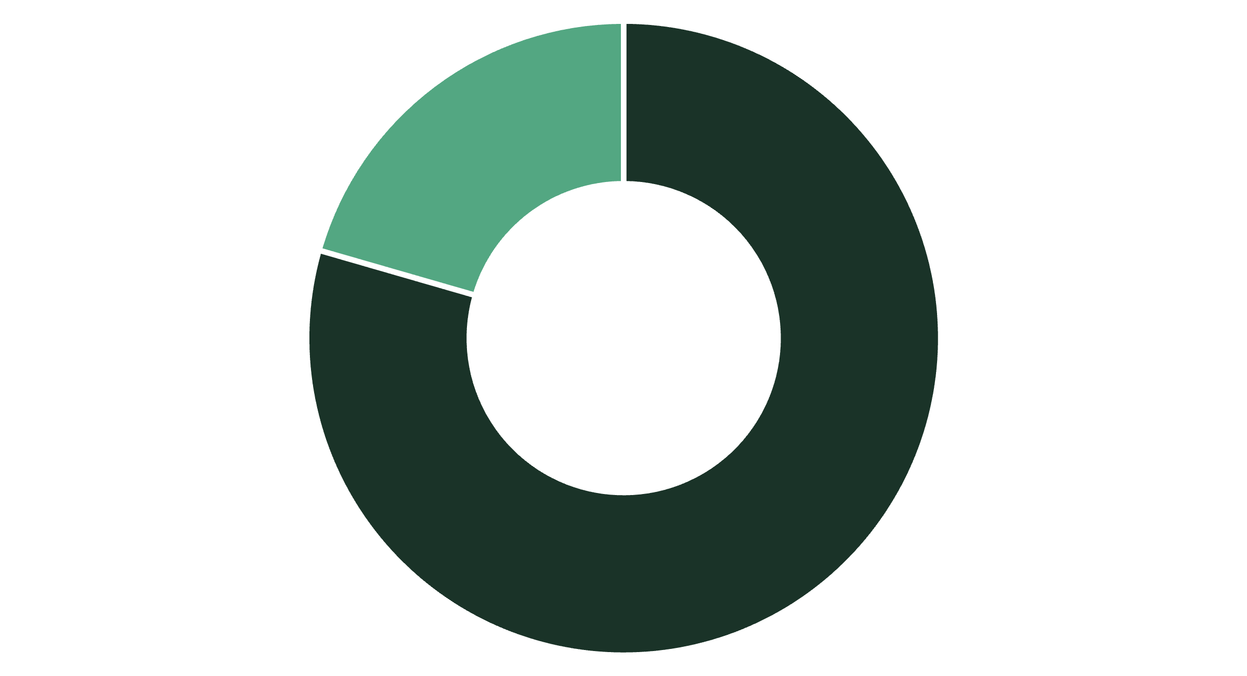
Churn Rate Analysis
Active
Churned
Overall Churn Rate
20.4%
Customers Lost
2,038 out of 10,000 customers have churned
Understanding this baseline helps identify which segments exceed the average churn rate and require immediate attention.

Slide 7
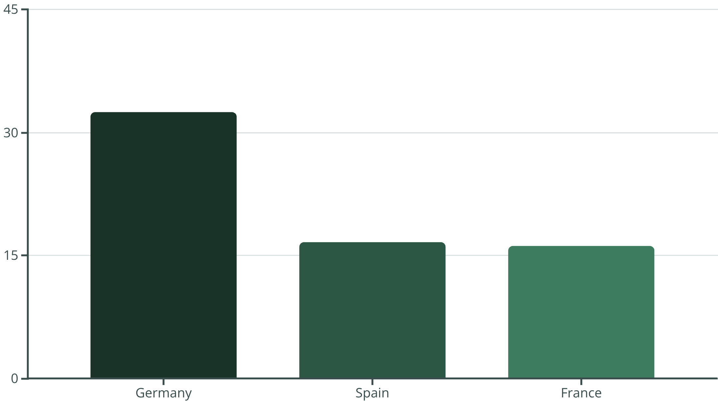

Geographic Churn Patterns
Germany Leads in Churn
Germany's churn rate of 32.44% is significantly higher than the overall average of 20.4%.
This represents 814 churned customers out of 2,509 total German customers, indicating a critical need for targeted retention strategies in this market.
Female customers in Germany show the highest churn rate at 37.55%

Slide 8




Customer Demographics
Age 18-30
Age 31-45
Age 46-60
Age 61+
1,968 customers
5,921 customers
1,647 customers
464 customers
Churn rate: 7.5%
Churn rate: 15.8%
Churn rate: 51.1%
Churn rate: 24.8%
Middle-aged customers (46-60) show the highest churn risk, requiring focused retention efforts.

Slide 9

Financial Profile of Churned Customers
Average Balance
$91,109
Churned customers hold higher balances than active customers ($72,743)
Credit Score
650.5
Average credit score across all customers
Zero Balance
3,617
Customers with no account balance

Slide 10
Key Findings & Recommendations
Geographic Focus
Age-Based Strategy
Inactive Members
Product Strategy
Prioritize retention programs in Germany where churn rate is 32.44%, especially targeting female customers.
Inactive customers show highest risk. Implement engagement campaigns to reactivate dormant accounts.
Customers with 3-4 products show 82-100% churn. Review product bundling and pricing strategies.
Develop specialized offerings for 46-60 age group with 51% churn rate to address their unique needs.
High-Value Retention
Churned customers hold higher balances ($91K vs $73K). Focus on retaining high-value accounts.

